Slide 1


m
Kimoha Technologies
Changing People, Processes & Perceptions

Slide 2



















About US
Kimoha Technologies helps your business to deliver better IT Solutions in a dynamic market environment. Our technical expertise in the North American markets,
it has earned for itself a reputation for providing cutting edge technical solutions. Our industry and market specific focus coupled with our dedication to customer satisfaction has made us one of the most trustworthy and reliable companies in the world of IT field.
500+
Placements in last 6 years
340 %
Overall Business Growth (2021)
150
Subcontractor
340% growth
125
Public & Private sector Customers
220% growth
290% growth
125% growth
95% growth
2017 2018 2019 2020 2021
www.kimohatech.com
Page NO. (1)

Slide 3
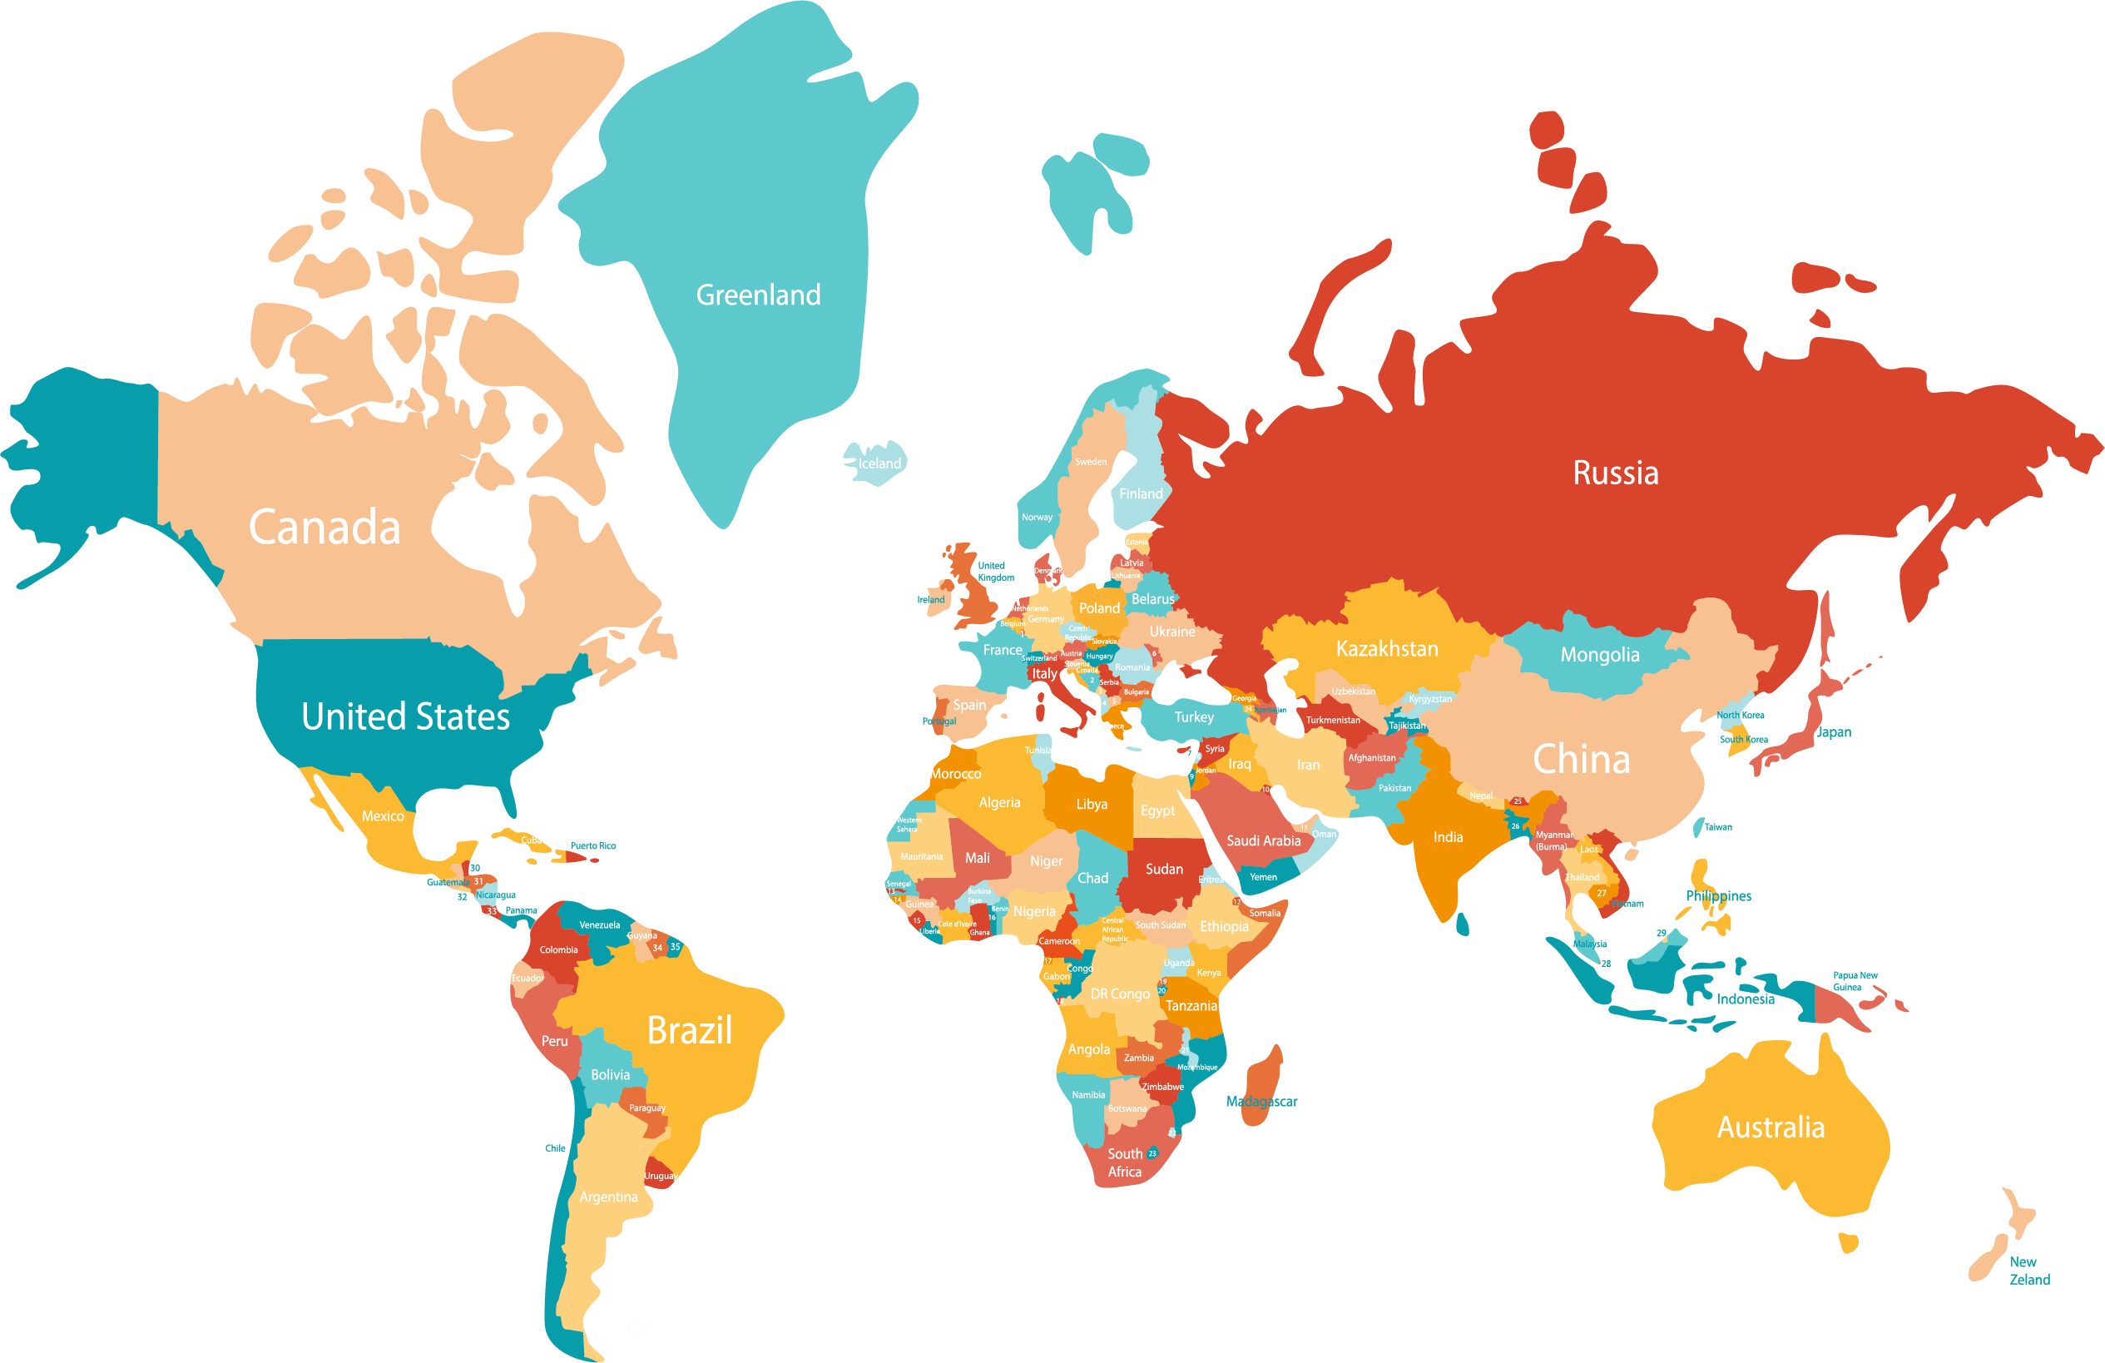


Geographical Coverage
Office Location : US
HQ: IT Park, Chandigarh
Other USA office locations.
Westlake Village, CA
Mechanicsville, VA
Raleigh, NC
Laketowne Drive Albertville, MN
Lexington, SOUTH CAROLINA
Kennewick, WA
Geographic Strength : Target market
Office Locations : Canada
Australia I Canada I India I New Zeeland I USA
Alberta, CA
www.kimohatech.com
Page NO. (2)

Slide 4

Our Services
Data Engineering
Cloud Solutions
Data Science &
Advanced Analytics
Data Pipelines
Automation
www.kimohatech.com
Page NO. (3)

Slide 5





IT
Development
Product
Support
Product
Development
IT
Maintenance
www.kimohatech.com
Page NO. (4)

Slide 6
IT & Application Development :
Kimoha Technologies & ADMS COE comprises a team of global recruiting professionals dedicated to finding and attracting highly skilled and qualified resources in the most challenging technology It & Digital disciplines. We keep abreast on both industry trends and client expectations and train our recruiters to focus on specific areas of technology to both create a pipeline of highly qualified resources and to become Subject Matter Experts in the respective areas.
Telecom
Healthcare
Life Sciences
Banking & Financial Services
Embedded Hardware / Software Engineering
Creative & Digital
Retail & E-commerce
Travel & Hospitality
Telecom & Networking
Hi-Tech
Semiconductor
Media & Entertainment
Higher Education
Application Development & Software Engineering
Cloud Consulting, Development, Integration & Migration
Solution Engineering
DevOps Automation
Data Engineering
Data Science & Analytics
Blockchain
JAVA/J2EE, Microsoft, Opensource
UI/UX Design
Oracle, My SQL
BI, DW, Big Data, AI & Analytics, Power BI, Tableau
RPA & Intelligent Automation
Industry Specialization
Deliver the best talent anytime, every time
Skill Towers Serviced
www.kimohatech.com
Page NO. (5)

Slide 7

Data Engineering
Data Engineering services we perform:
Data discovery & Data maturity assessment
Data quality checks and standardization services
Cloud based scalable solutions for large volumes of data
Real-time and batch data processing
Optimization of database and data warehouse platforms
Advanced data analytics
Web API & data streaming development
Agile and customer-oriented work process
www.kimohatech.com
Page NO. (7)

Slide 8




Data Engineering
Data Architecture
Data Processing
Data Architecture
Design DE cloud solutions designed by a team of certified experts
Preparation and automation of ETL processes for multi-structured data
Design optimization of database and data warehouse platforms
Preparation of software solutions for integrating systems
Implementation of scalable data driven solutions+
Real-time and batch data pipelines & processing
Data quality and standardization services
Data integration & maintenance services
Data Lakes and Data Warehouses setup
Consultancy and preparation of a plan for analytical method development
Preparation of recommendation systems
Searching for patterns in sequential data
Quality evaluation of organizations’ analytical products
www.kimohatech.com
Page NO. (8)

Slide 9

Cloud Solutions
Cloud Solutions services we perform:
Data discovery & Data maturity assessment
Data quality checks and standardization services
Cloud based scalable solutions for large volumes of data
Real-time and batch data processing
Optimization of database and data warehouse platforms
Advanced data analytics
Web API & data streaming development
Agile and customer-oriented work process
www.kimohatech.com
Page NO. (9)

Slide 10
Cloud Solutions
Data Architecture
Data Processing
Data Analytics
Design DE cloud solutions designed by a team of certified experts
Preparation and automation of ETL processes for multi-structured data
Design optimization of database and data warehouse platforms
Preparation of software solutions for integrating systems
Implementation of scalable data driven solutions
Real-time and batch data pipelines & processing
Data quality and standardization services
Data integration & maintenance services
Data Lakes and Data Warehouses setup
Consultancy and preparation of a plan for analytical method development
Preparation of recommendation systems
Searching for patterns in sequential data
Quality evaluation of organizations’ analytical products
www.kimohatech.com
Page NO. (10)

Slide 11

Data Science & Advanced Analytics
Data Science & Advanced Analytics services
Making better decisions based on the powerful knowledge you gain from the data
Improving product quality and user experience by analyzing gathered data
Identifying new business opportunities by predicting behaviors based on historical data
Reducing costs and increasing profits by simplifying your data architecture
Reducing of project duration by speeding up the processes of accessing insights
www.kimohatech.com
Page NO. (11)

Slide 12






Data Science &
Advanced Analytics
Marketing Analysis and CRM
Cybersecurity and Fraud
Protection
Processing behavioural data of hundreds of
millions of customers
Analysis and optimisation of budgets in programmatic
Advertising
Sales trends analysis and prediction
Data enrichment and 3rd party data correlation
Collection and real time analysis of events collected
from distributed loyalty applications
Automation and optimisation of Machine Learning
models
Creation of statistical models predicting customers behaviours based on past event sequences
Optimisation of TV ads channel and time placement
decisions
Systems monitoring billions of packets daily for
early network attack detection and mitigation
Analysis and prediction of event sequences leading to customer churn
Natural Language Processing for fraud risk
assessment
Machine Logs processing for data leakage
monitoring and suspicious traffic patterns detection
Social Network Analysis for fraud rings
identification and other organized fraud scenarios
monitoring
Supply Chain management
IoT
Video Processing
Image segmentation and classification for business process automation
Automatic pattern detection and visual search
Automated anomaly detection in visual inputs
Visual search and recommendation Engine development based on convolutional networks
Processing and transformation of multi-structured data
AI based cost monitoring solutions
Integration and transformation of Machine logs
Collection and analytics of real time IoT data feeds
Building event-based campaigns and pipelines (anomaly detection, sensor data processing)
www.kimohatech.com
Page NO. (12)

Slide 13

Data Pipeline Automation
Data Pipeline Automation services we Perform:
Design of the end-to-end data flow architecture
Implementation of cloud based ETL processes
Integration with existing data sources and services
Design and development of the data driven applications
www.kimohatech.com
Page NO. (14)

Slide 14




Data Pipeline Automation
Cloud Toolset
Open Source
Analytical Databases: Big Query, Redshift, Synapse
ETL: Databricks, DataFlow, DataPrep
Scalable Compute Engines: GKE, AKS, EC2, DataProc
Process Orchestration: AirFlow / Composer, Bat
Platform Deployment & Scaling: terraform, custom tools
Support for all Hadoop distributions: Cloudera, Hortonworks, MapR
Hadoop tools: hdfs, hive, pig, spark, flink
No SQL Databases: Cassandra MongoDB, Hbase, Phoenix
Process Automation: oozie, Airflow
Visualisation Tools
Programming Skills
Power BI
Tableau
Data Studio
D3.js
Python: numpy, pandas, matplotlib, scikit-learn, scipy, spark,
pyspark & more
Scala, Java
SQL, T-SQL, H-SQL, PL/SQL
www.kimohatech.com
Page NO. (15)

Slide 15

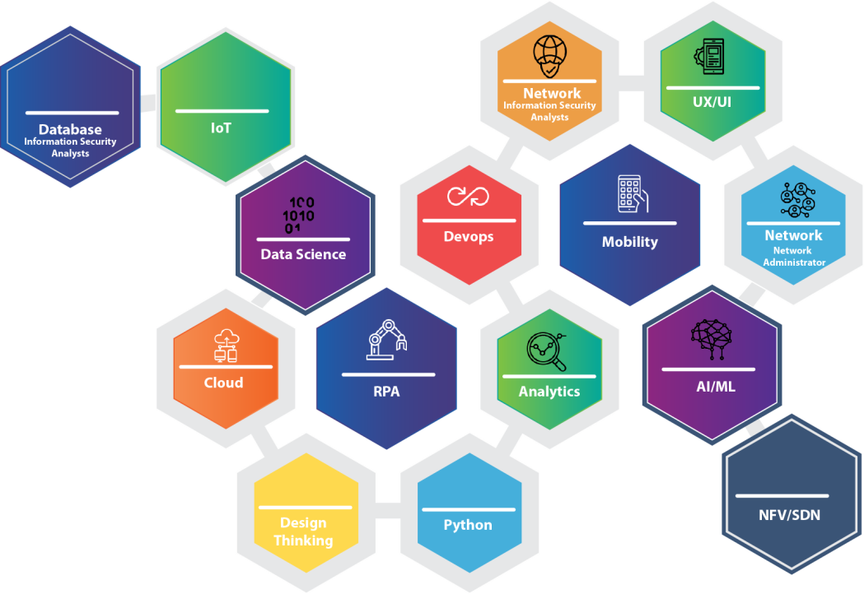

IT SKILLS
TOP IN THE IT INDUSTRY
Web Architecture &
Development Framework UI Design | UX Design
Database Developer
Hadoop | EPL
Data Visualization |
Data Scientist | Data Engineering
AWS | Cloud Architect
Cloud System Engineer
Distributed Computing
www.kimohatech.com
Page NO. (6)

Slide 16

THANK YOU !
Point of Contact : Mr. Naveen Kumar Phone : (215)709-0250, Ext 8007 Email : Naveen@iserveworld.com
GLOBAL LOCATIONS
USA | India
175 Strafford Avenue, Suite one # 907, Wayne, PA 19087 Other USA office locations. Westlake Village, CA Mechanicsville, VA Raleigh, NC Laketowne Drive Albertville, MN Lexington, SOUTH CAROLINA Kennewick, WA | 4th floor, Plot No. 10, Rajiv Gandhi IT Park, Netsmartz House Building Chandigarh, 160101 205 A Bestech Towers, Mohali Punjab 160066
 | Canada –
 | 3456 28st, Edmonton, Alberta, CA T6T2A5

